Slide 1
Gender Inclusive Design

Slide 2
Learning Outcomes
Describe gender issues in ICT/STEM and inclusive design
Express the basic components of the GenderMag method
Apply the GenderMag method
Be able to formulate a plan to evaluate a software product to investigate gender issues
Critically appraise work on gender and inclusive design

Slide 3
Gender stereotypes
Like the rest of society, misunderstandings and stereotyping have made their way into tech. Like:
Women are emotional, men are more logical.
Men are better at maths, women are better at languages.
Men make great computer scientists, women make great nurses.
Women like pink, men like blue.
Gender roles perpetuated in novel technology such as voice assistants.
Notes:
Read Slide
Voice assistants by default use female voices perpetuating the stereotype of women in service roles. Such stereotypes affect the. perception of women’s roles in tech.

Slide 4
“Pink it and shrink it”
Where gender is acknowledged, the tendency is to apply a “pink it and shrink it” approach to design.
Aesthetics become genderised.
Notes:
Pink it and shrink it is not a solution as it is a shortcut to make products essentially designed for men aesthetically appeasing to other genders. In fact ,can end up reinforcing stereoyopes.

Slide 5
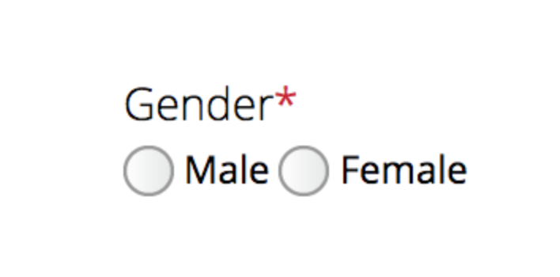
Binary gender choices
Gender is often perceived as binary.
Choose between two options: Male or Female.
Features associated with these binary choices can constrain use.
Notes:
A simple example where binary choices can constrain users who do not identify as either.

Slide 6
Are there gender differences underlying these stereotypes?
“Essentialist” response:
Yes, there are innate differences between men and women with respect to how they think, behave, etc. That’s the way things are so we need gendered designs.
“Cultural” response:
No, men and women are very similar and any differences are due to society’s ways of shaping and controlling behaviour. We need a feminist agenda and gender-neutral designs.
“Pragmatic” response:
Yes, but we are not sure if they are due to nature or nuture. However, we need systems that are gender-inclusive, i.e. support a variety of users.
Notes:
Read slide

Slide 7
Gender and cognitive and behavioural impacts
Research shows that there are differences between genders and their technology use https://www.nowpublishers.com/article/Details/HCI-056
Not accounting for them in design can lead users to pay a ”cognitive tax”.
Differences include:
Perception of vision and sound.
Language and communication.
Information processing styles.
Attitudes to risk.
Self-confidence and the belief in ability to succeed doing tasks (self-efficacy).
Reasons for using technology.
However, there’s no evidence of any differences based on intelligence, drive to succeed or mathematical ability.

Slide 8
The development of gender differences
Infancy
Hardly any, other than female infants quicker at motor development (but males catch up quickly)
No differences in temperament, activity level and social skills
However, how other people respond to gender is different
Childhood
Gender identity and associated behaviour become entrenched early
Adulthood
Differences “enculturated”
But careful: gender is dimensional, not categorical [Carothers and Reis 2012] https://www.sas.rochester.edu/psy/people/faculty/reis_harry/assets/pdf/CarothersReis_2012.pdf
Notes:
Read slide

Slide 9
Why gender-inclusion matters - Market potential [Stumpf et al. 2020]
There’s a roughly equal split between men and women in the worldwide population.
Research showed that for some applications, women make up more than 50% of the market.
By failing to heed gender-inclusion issues:
You may have created a weaker user experience for half – or more than half – of your target market.
You’ve wasted some of your team’s efforts.
Notes:
There are many arguments to why we must pay attention to gender inclusive design, one is the market argument.
Read slide

Slide 10
Why gender-inclusion matters - Ethics
Gender-inclusion is ‘the right thing to do’.
If we don’t design gender-inclusively we might:
Impair one section of society’s ability to achieve their goals – personally or professionally.
Cause an imbalance in participation, knowledge and skills throughout society.
Contribute negatively to issues of education and career choices, recruitment into STEM fields and disciplines.
Reinforce stereotypes.
Notes:
Another argument emphasizes ethics. Either way we can create software that excludes several kinds of users.
Read slide

Slide 11
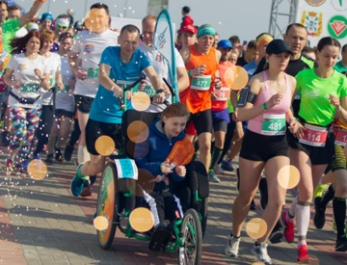
Inclusion
But remember, it’s not about building different versions of your products.
Just make one version that lets everyone have a great experience!
Notes:
Read slide

Slide 12
Designing for gender-inclusively?
“How can ordinary practitioners, with no background in gender research, identify which aspects of their software have gender-inclusiveness issues, realize why those issues are issues and thereby know what they should change?” [Burnett et al. 2016]
https://academic.oup.com/iwc/article-abstract/28/6/760/2417082?redirectedFrom=fulltext
Notes:
Read quote to emphasize we don’t need to have a background in gender studies to create gender inclusive software.

Slide 13
Introduction to GenderMag
GenderMag is a well-researched, structured approach for evaluating – and fixing – technology products and services.
It consists of three parts:
A set of cognitive styles for using technology that statistically cluster by gender. ​These are the 5 facets.
A set of a fictional people who have a particular value for each of the 5 facets, plus some background and other characteristics to bring the facets to life. These are personas.
A prescribed series of steps a team can take to see how these personas might carry out a function using specific technology to uncover gender-inclusion issues. This is the evaluation walkthrough.
Notes:
Read slide

Slide 14
Introduction to the 5 facets
It’s worth noting that these facets are tendencies of behaviour along a spectrum.
Behaviour will vary according to every individual.
However, there are clusters of behaviour that tend to show more prevalently according to gender.

Slide 15
1. Information processing style
To solve problems with technology, people need to look at, and understand, new information.
Research showed that men tended to select promising leads, then backtrack if needed when using problem-solving technology.
Women tended to gather information more comprehensively, collecting a fairly complete set of necessary information before proceeding.

Slide 16
2. Learning style for new technology
In our research, men were much more likely than women to “tinker”. That is, playfully engage with a piece of technology on the way to learning it.
Women tended to follow a process when it came to learning.
Note though that when women did tinker, they tended to do so more mindfully than men, and learned more thoroughly.
Notes:
Sometimes we relate tinkering to bottom-up-ishness (eg, starting with the raw ingredients) and process to top-downishness (eg starting with the recipe)

Slide 17
3. Computer self-efficacy
This concerns a person’s confidence that they’ll succeed at a specific task using technology.
It’s important because it concerns how likely a person is to give up on a task, and how they cope when presented with obstacles.
Research showed that men tended to have higher computer self-efficacy than women.
Notes:
men tended to have higher computer self-efficacy than women mainly due to historical reasons such as marketing computer tools and machines to men more than women

Slide 18
4. Attitude to risk
Research has indicated that women tend to be more risk-averse than men.
This means that women may not engage with certain technology feature sets as they may consider the risk of using them and wasting their valuable time to be too high.
Notes:
Due to historical socio-cultural reasons

Slide 19
5. Motivations
Why is the person using this technology
Research showed that the tendency to use technology for the love of technology is more prevalent among men.
Women tended to use technology because they had a particular task to carry out.
Notes:
Again, remember this may not apply to you as an individual but such behavior is clustered around gender groups.

Slide 20







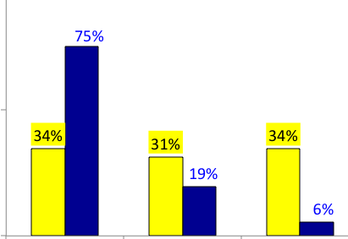




Introduction to GenderMag personas
GenderMag uses 3 personas: Abi, Tim and Pat.
Each has a customisable ‘back story’, so they’re very flexible; they’re designed to work across a wide range of settings.
Each persona has facet characteristics that correspond to research-backed facet values. These can’t be altered.
Tim
Pat
Abi
http://gendermag.org/
High
Medium
Low
Notes:
Here is the first step in the Gender Mag method. Define and use personas. The method gives us three personas to work with.
Read slide

Slide 21
GenderMag personas - Abi
Her behaviour reflects facet values commonly seen in women during the research, such as high risk-aversion, low self-efficacy, and so on.
For GenderMag evaluations, you’re likely to use this persona a lot.
Abi contrasts heavily with Tim, who we’ll meet next.
Personas

Slide 22
GenderMag personas - Tim
His behaviour reflects facet values strongly associated with men.
Significantly, Tim and Abi have exactly the same background and job; they should only be different when it comes to the way they reflect the 5 facets.
Personas

Slide 23
GenderMag personas - Pat
They’re designed to cover the large fraction of users – men and women – who don’t fit Abi’s or Tim’s behaviour profile. They are somewhere in-between the spectrum.
Again, they have exactly the same profile background as Abi and Tim, only varying regarding their alignment with the 5 facets.

Slide 24
The GenderMag walkthrough
GenderMag uses a variation of a usability evaluation process called a Cognitive Walkthrough.
Rather than testing design features directly with users, a walkthrough enables non-users to work with a paper or implemented interface.
Following a defined set of questions, the evaluator can ascertain whether a prospective user is likely to be able to use the feature or function in question.
This process is part of the GenderMag evaluation.
Notes:
The walkthrough is akin to debugging. Except here you are looking for inclusivity bugs!

Slide 25
The Walkthrough: Preparation
Preparation step 1
The first step of your GenderMag evaluation is to choose the technology and use case to evaluate.
Preparation step 2
Next, choose a persona and customise it.
Preparation step 3
Schedule your walkthrough session for 2 hours with your evaluation team. In a pinch, it can be done by one person.
Preparation step 4
Prepare your materials including reporting forms.

Slide 26
The Subgoal Report form
This is the form you’ll use to evaluate the success of your subgoal. It clearly states:
The use case
The current subgoal
The single question “Will [persona name] have thought of this as a step toward achieving the overall use case?”
This form also documents the evaluation
Notes:
The main focus of this step is ask “Will Persona X have thought of this as a step toward achieving the overall use case?”.

Slide 27
The Action Report form
You’ll use this to record actions taken along the use case.
It’s in two parts: before and after.
The first part asks whether the persona would take the action.
The second part asks whether the persona would know they’re making progress toward their goal.
Again, it forms part of your evaluation’s documentation.
Notes:
Read slide. Emphasize the red highlights.

Slide 28
The Walkthrough: Evaluation
Once you’re fully prepared, you can get on with your actual evaluation.
Evaluation Step 1
Decide on and write down your use case’s subgoals.
Evaluation Step 2
Evaluate each subgoal.
Evaluation Step 3
Evaluate the actions you hope your persona would take within the current subgoal before taking this action and after performing the action.
Evaluation Step 4
Debrief by counting issues and deciding on how to resolve them.

Slide 29
Applying GenderMag: StackOverflow Walkthrough
Preparation
The first step will be to customise your persona. In this case we’ll use Abi. Characteristics:
Lower computer self-efficacy, Process-oriented, Risk-averse, Comprehensive information processing style
Then set your use case:
Abi wants to ask a programming question
Then set your subgoals:
Find where to ask a question
Understand how to write a good question
Add appropriate tags
Notes:
Ask students how they would customize the persona, if they can think of any other subgoals

Slide 30
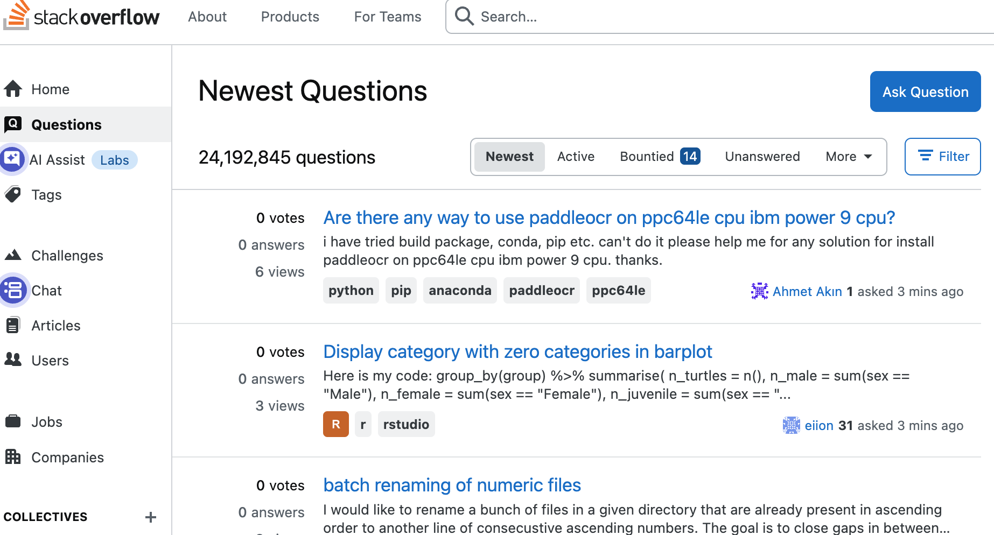
Applying GenderMag: StackOverflow Walkthrough
Subgoal 1: Know how to ask a new question
Use case (What is to be achieved overall): Share captioned video with her students
Subgoal: Get to Asking a new Question
Will Abi have thought of this as a step toward achieving the overall use case?
☐ Yes | Facets Considered? ☐ Motivations ☐ Information Processing Style. ☐ Computer Self-Efficacy ☐ Attitude Towards Risk ☐ Learning: by Process vs. by Tinkering ☐ None of the above | Why?
☐ Maybe | ☐ Motivations ☐ Information Processing Style ☐ Computer Self-Efficacy ☐ Attitude Towards Risk ☐ Learning: by Process vs. by Tinkering ☐ None of the above
☐ No | ☐ Motivations ☐ Information Processing Style ☐ Computer Self-Efficacy ☐ Attitude Towards Risk ☐ Learning: by Process vs. by Tinkering ☐ None of the above
Notes:
Ask students if Abi will have thought of this step to get to the subgoal?
E.g.,
Yes, Abi would have.
Facet considered: Motivation as she is motivated to get an answer to the question. She learns by process, so she expects to achieve her goal step by step. The first natural step is to be able to ask a new question.

Slide 31
Applying GenderMag: StackOverflow Walkthrough
Subgoal 1: Ask a new question
Action 1, Part 1: Click on Ask a new question
Action: Click on Ask a new question button
Part 1. Before action is taken Will Abi do this?
☐ Yes | Facets Considered? ☐ Motivations ☐ Information Processing Style ☐ Computer Self-Efficacy ☐ Attitude Towards Risk ☐ Learning: by Process vs. by Tinkering ☐ None of the above | Why?
☐ Maybe | ☐ Motivations ☐ Information Processing Style ☐ Computer Self-Efficacy ☐ Attitude Towards Risk ☐ Learning: by Process vs. by Tinkering ☐ None of the above
☐ No | ☐ Motivations ☐ Information Processing Style ☐ Computer Self-Efficacy ☐ Attitude Towards Risk ☐ Learning: by Process vs. by Tinkering ☐ None of the above
Notes:
Ask students.
E.g., response:
Maybe.
Abi is motivated to get an answer
Abi has need to have all the information available before proceeding. She isn’t sure what will happen when she clicks on that button
She has low computer self efficacy so she may not click on the button after all as she does not know what may happen

Slide 32
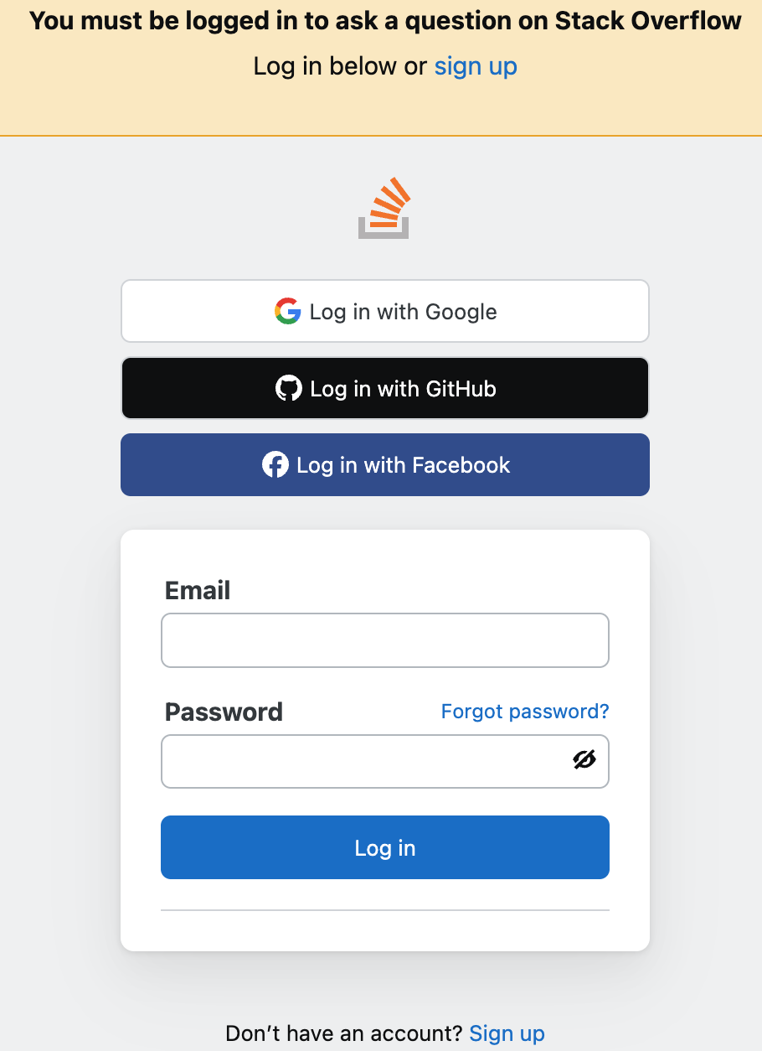
Applying GenderMag: Example Walkthrough
Subgoal 1: Ask a new question
Action 1, Part 2: Click on Ask a new question
Action: Click on Ask a new question button
Part 2. After action will Abi know she did the right thing?
☐ Yes | Facets Considered? ☐ Motivations ☐ Information Processing Style ☐ Computer Self-Efficacy ☐ Attitude Towards Risk ☐ Learning: by Process vs. by Tinkering ☐ None of the above | Why?
☐ Maybe | ☐ Motivations ☐ Information Processing Style ☐ Computer Self-Efficacy ☐ Attitude Towards Risk ☐ Learning: by Process vs. by Tinkering ☐ None of the above
☐ No | ☐ Motivations ☐ Information Processing Style ☐ Computer Self-Efficacy ☐ Attitude Towards Risk ☐ Learning: by Process vs. by Tinkering ☐ None of the above
Notes:
Ask students.
E.g., response:
Maybe.
Abi is motivated to get an answer
There is a clear message that tells Abi to login to ask a new question. But she isn’t sure that after logging in if she will be go back to the page that allows her to ask a new question
Having low computer self efficacy she may not proceed as a result of being unsure.

Slide 33
Debrief
How to identify gender-inclusion issues:
All the “no” and “maybe” answers on the forms with a facet checked.
How to identify usability issues
All the “no” and “maybe” answers on the forms without a facet checked.
Prioritization of issues:
All the “no” answers point to definite issues that can be blockers in the path to what the user wants to achieve. Should resolve these fairly quickly.
All the “maybe” answers point to potential problems that users might encounter. They might be slowed down in achieving want they want to do and so you should try to resolve these but it’s not a top priority.

Slide 34
The Walkthrough: Ground rules
Five things to remember are:
1. Stay true to the persona.
It’s not about what you or people you know might do.
2. Follow the sequence.
Don’t try to predict a sequence of events that the persona might follow.
Only evaluate the set of actions the designer or developer wants the persona to do.
3. Answer every question.
Don’t skip any question or step.
Answer them all as if your persona has gone this far.

Slide 35
The Walkthrough: Ground rules
4. Just find the issues
Don’t try to fix issues during the walkthrough; wait until you’re finished.
5. You don’t have to agree with each other
This is not an exercise in consensus building. If one person in a team finds an issue, chances are a percentage of users will have that issue too. Note them all during the walkthrough.

Slide 36
Reading
Burnett et al. (2016) GenderMag: A Method for Evaluating Software's Gender Inclusiveness. Interacting with Computers.

